Slide 1
Data Analysis

Slide 2



Presenters
Abhijit Nelli
15
45/45
Jash Patel
15
45/45
Mohit Jain
15
45/45
NEXT

Slide 3
Today, we're going on an adventure to explore the world of Pokémon.
Pokémon = Pocket Monsters

Slide 4
To start with Data Collection, Data Cleaning and Understanding the Data

Slide 5
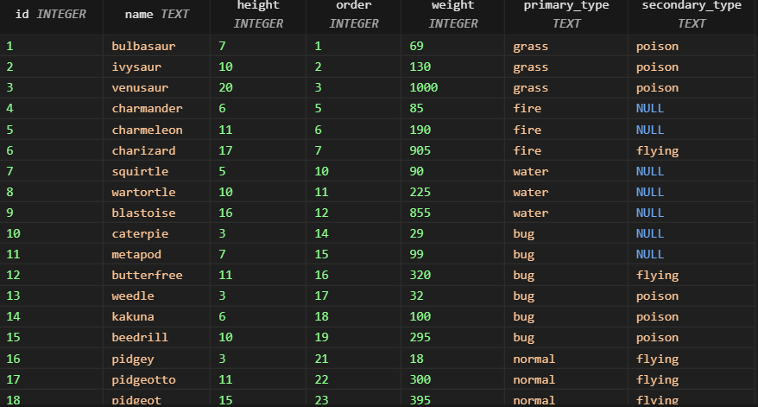
Table 1: Pokédex (pokedex)

Slide 6
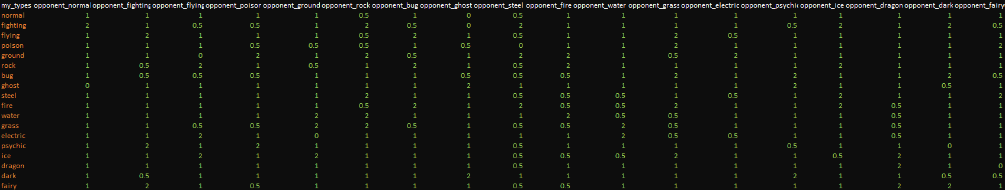
Table 2: Pokémon Advance Types (adv_types)

Slide 7
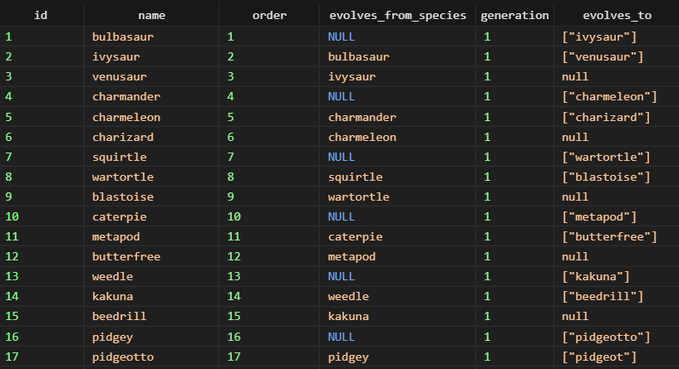
Table 3: Pokémon Evolutions (evolutions)

Slide 8
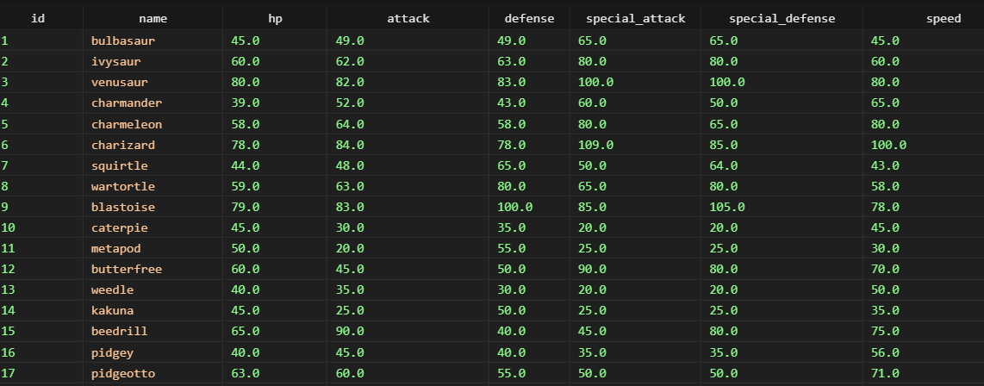
Table 4: Pokémon Base Stats (stats)

Slide 9
Exploratory Data Analysis:

Slide 10
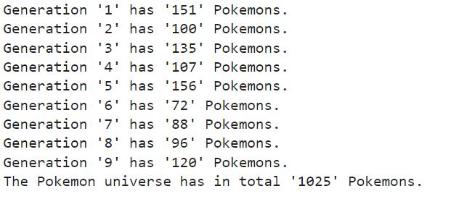
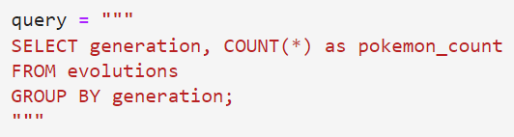
1) How many Pokémons are there in each generation?

Slide 11
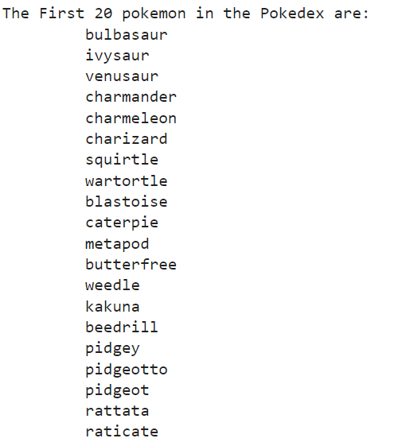
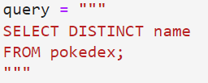
2) What are the different Pokémon species in the Pokédex?

Slide 12
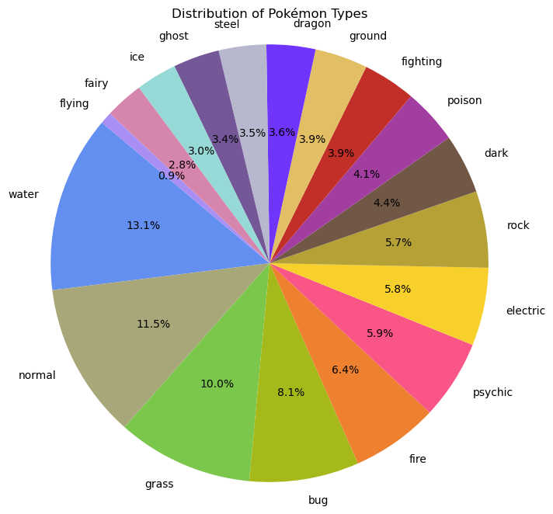
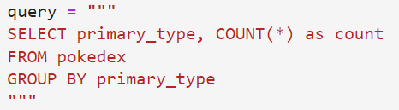
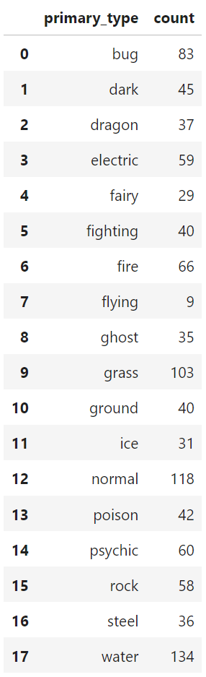
3) What is the distribution of Pokémon types in the Pokédex?
Notes:
Hello guys my name is Mohit Jain. I will continue from here where I will be explaining on the different types, generations and stats.
Moving on towards to analysis We are looking at the primary type of the pokemons and using the query we got the output on the left dataframe which show that water is the highest with 134 pokemons and flying is 9 at the lowest. An interesting fact not all pokemons have just a single type they have dual types as well. To see the distribution of single vs dual we move to the next slide.

Slide 13
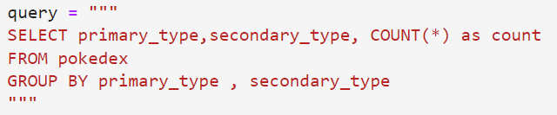
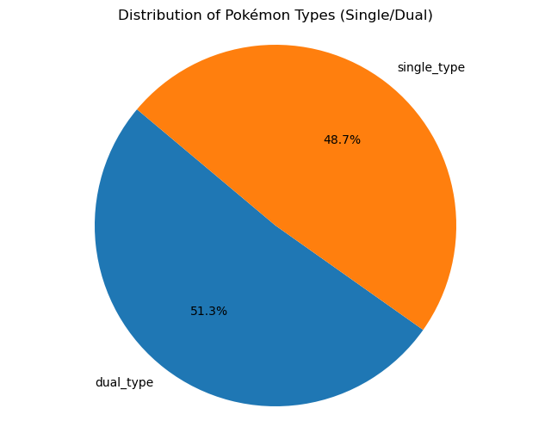
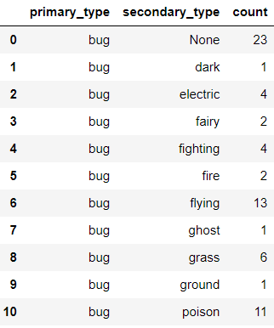
4) How is the distribution of Pokémon types(Single/Dual) among all the Pokémons?
Notes:
This shows the Distribution of the types and as you can see that both the types have almost even distribution with 48.7% for single and 51.3 for dual.

Slide 14
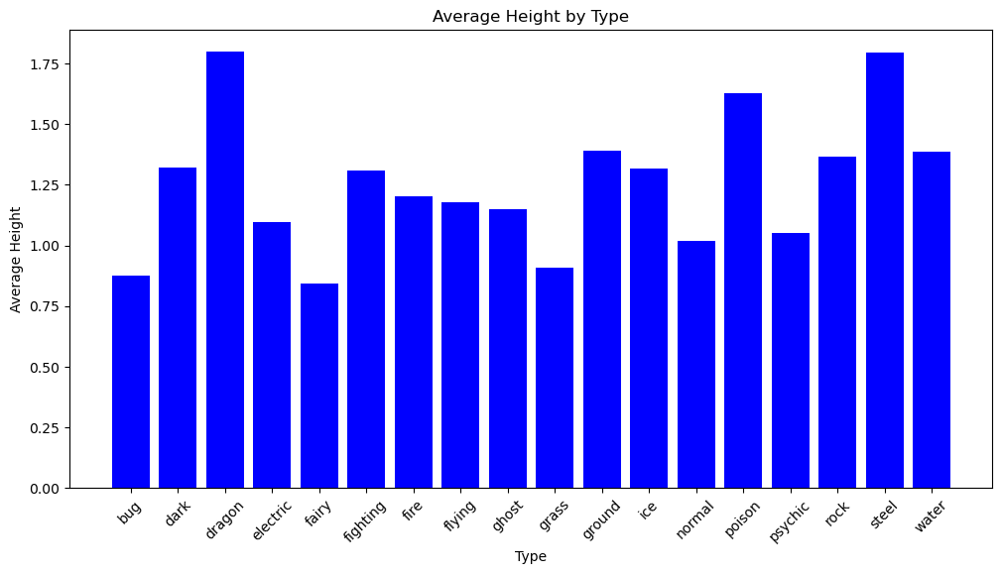
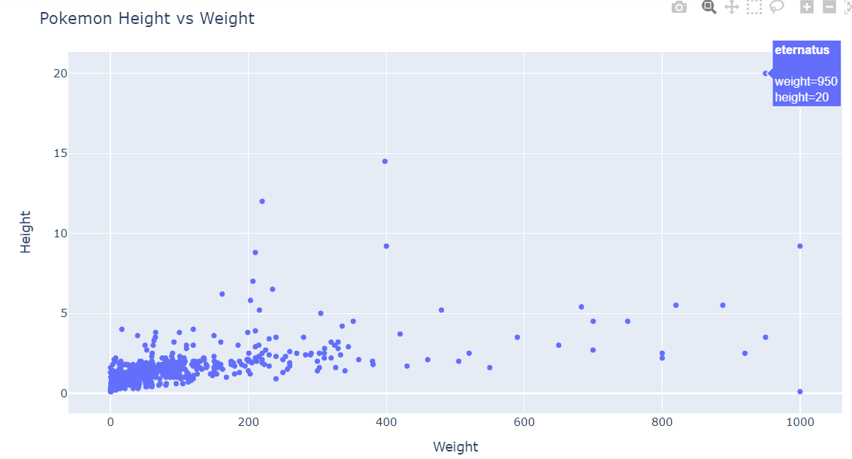
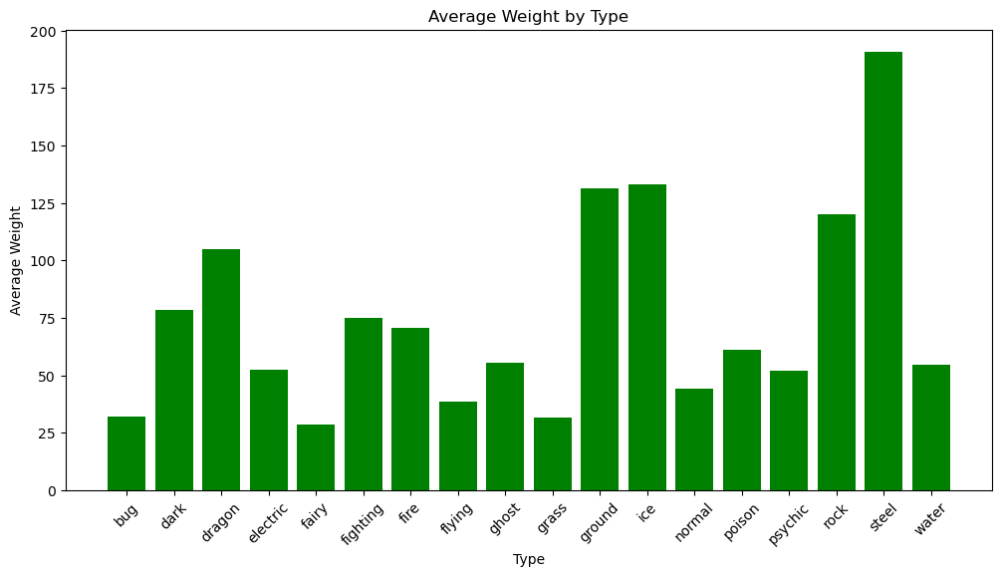
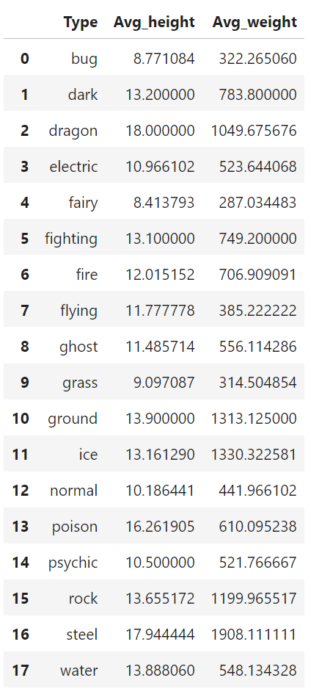
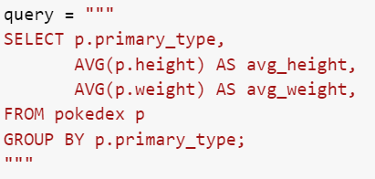
5) How does the height and weight of Pokémons vary across different types?
5) How does the height and weight vary for Each Pokémon?
Notes:
Now we started looking into the height and weight of the pokemon in meters and kilograms respectively. And to see their avg by type. Explain he graph and 2 examples for height. And 2 examples for weight. Now to understand the distribution of the pokemon height against weight of all pokemon we have plotted a scatter plot with height in x and weight in y axis. As yiou can see most of the values lie in the range of 0-5 m and 0 to 200 kg. with some exceptions. In those as you ca notice eternatus has the highest height at 20m and weight of 950 kg and the pokmeon with the smallest height is cosmeum at 0.1m and 1000kg.

Slide 15

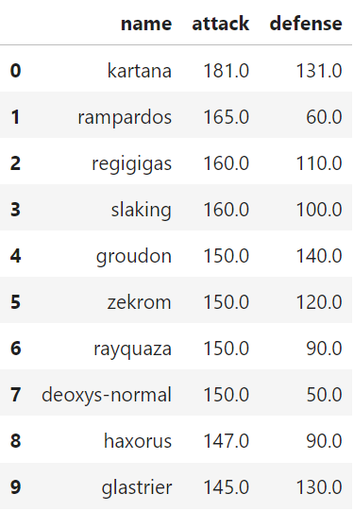
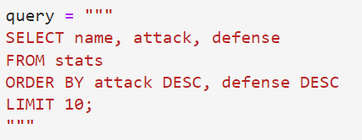


6) Which Pokémon have the highest attack and defense?
Notes:
Now we are going to look at each pokemons basic stats and find the best and the worst stats for each. At first to look at the pokemon with the highest attack and defense combinations we used a query and found the following for the same. Ordering by attack firat and then defense in descending order.

Slide 16
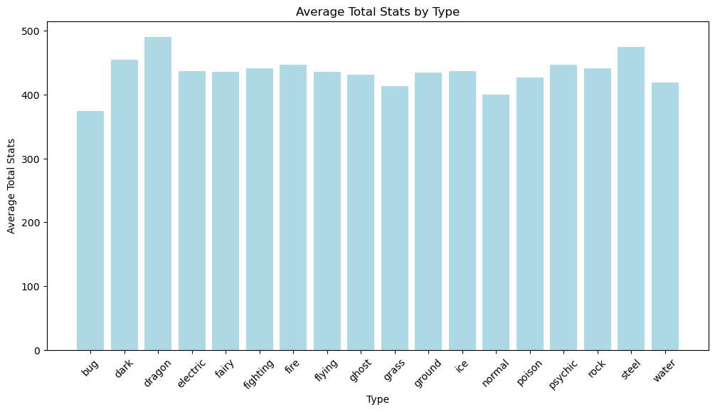
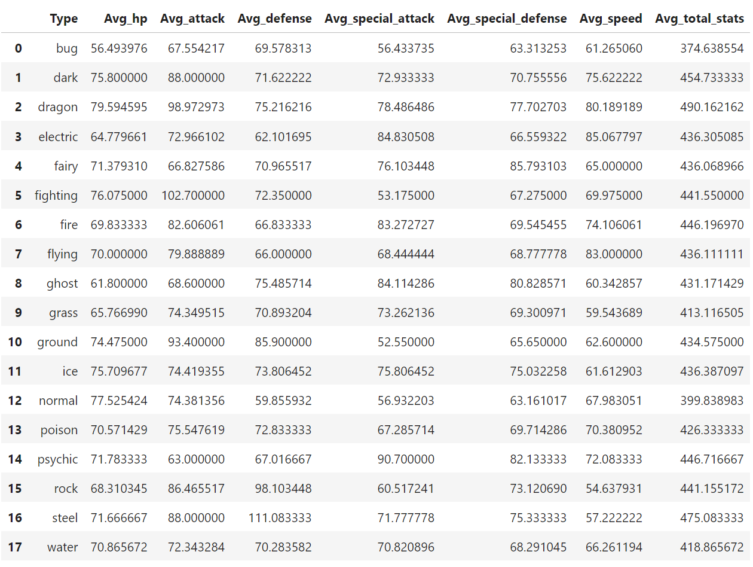
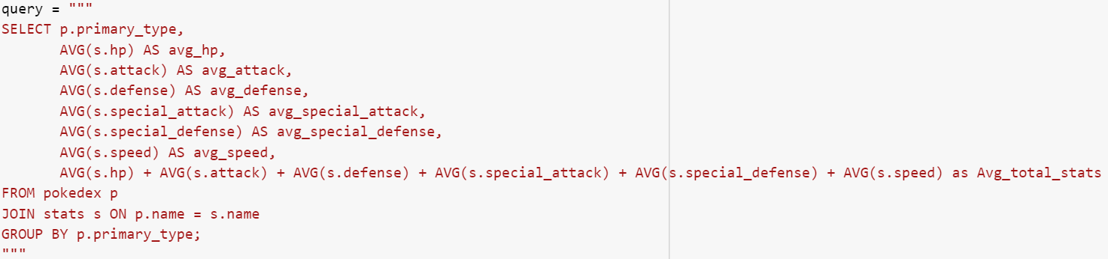
7) How does the base stats of Pokémons look across different types?
Notes:
After looking at a few of the pokemons stats we looked at the type wise grouping for each stat and we have take the average to underdstand which type of pokemon have a higher base avg stat. as you can see that the dragon type has the highest base average stats as compared to the rest of the types.

Slide 17
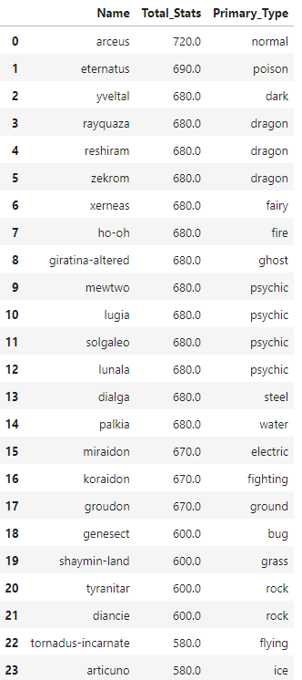
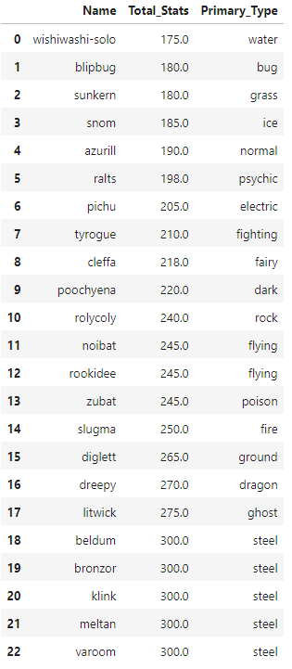
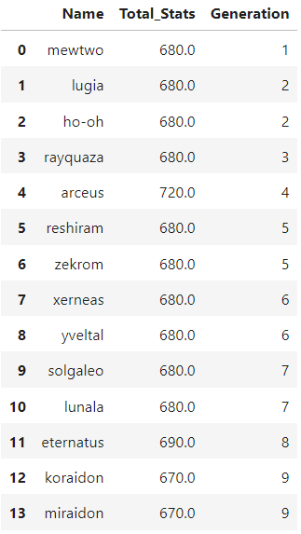
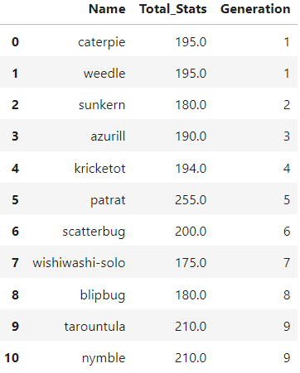
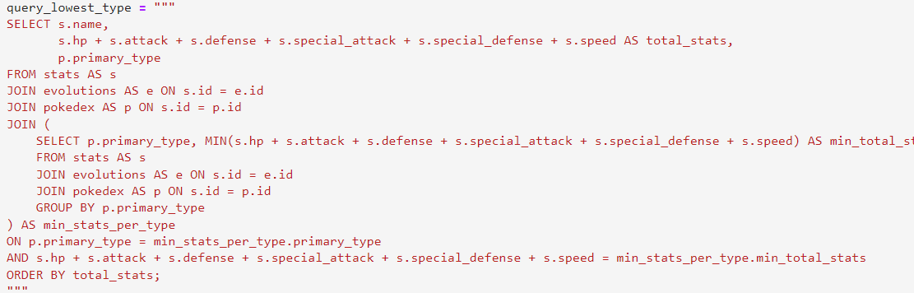
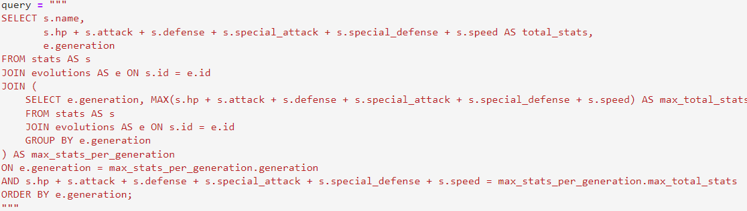
8) Which Pokémon have the highest and lowest total stats (HP, Attack, Defense, Special Attack, Special Defense, Speed) by Generation and Type?
Notes:
From looking at the previous analysis we wanted to find the pokemons with the highest total base stats and so we queryied the same and found the pokemon wit the highest stat and lowest base stat. with arceus being the highest at 720 which is the maximum possible total base stat a pokemon can have. Now my friend is gonna continue for some more interesting insights in the dataset.

Slide 18
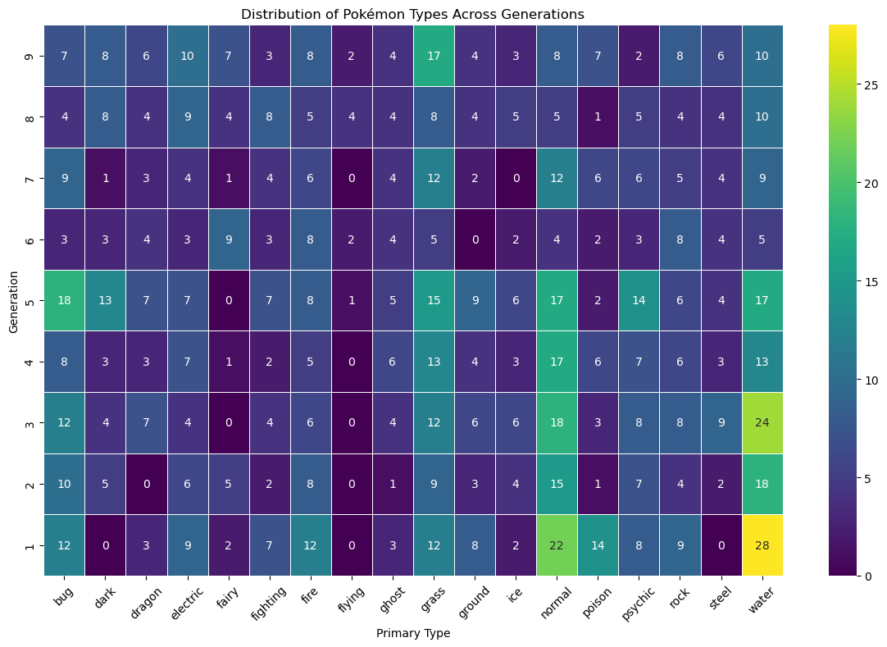
9) How does the distribution of Pokémon types vary across different generations ?

Slide 19
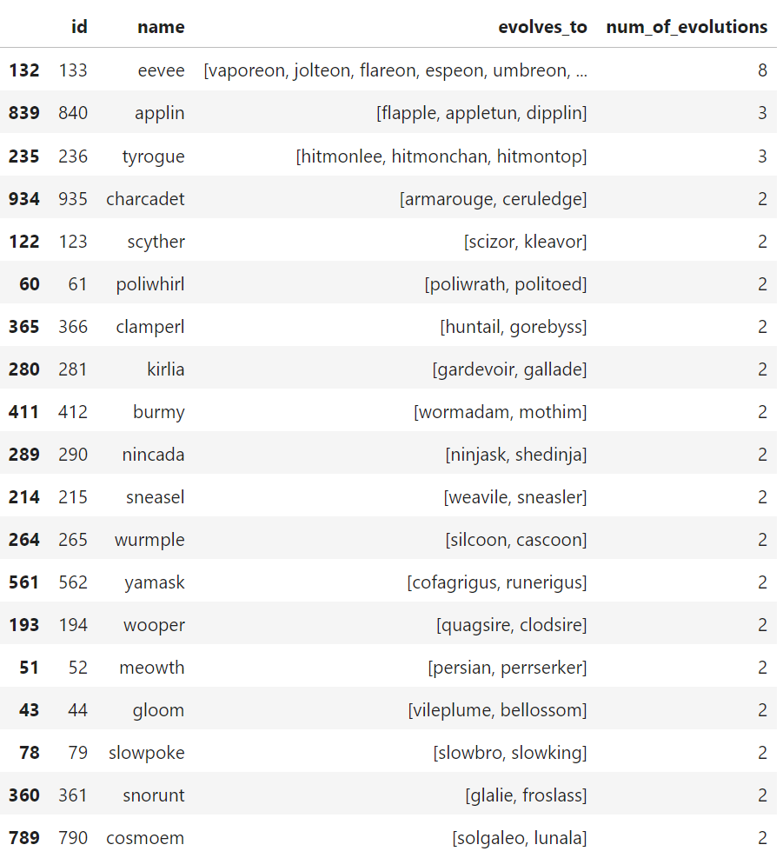
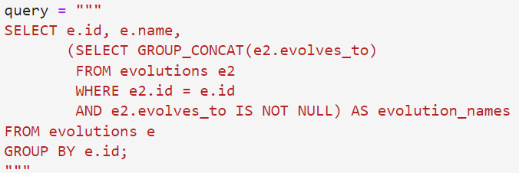
10) How many evolutions exist for each Pokémon, and what are their names?

Slide 20
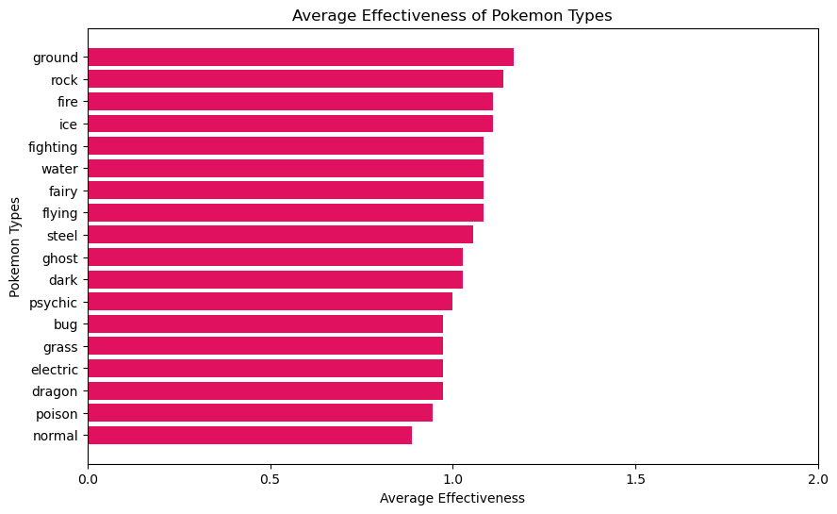
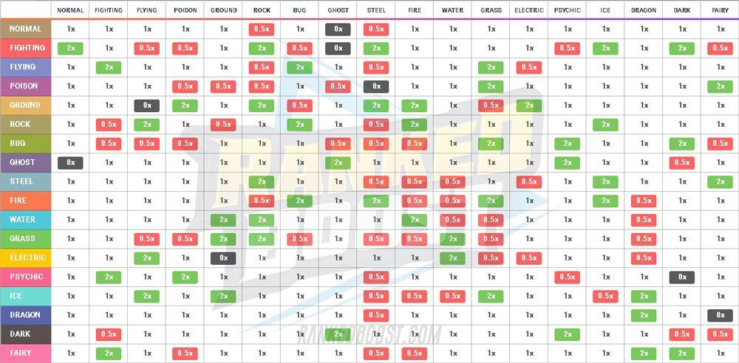
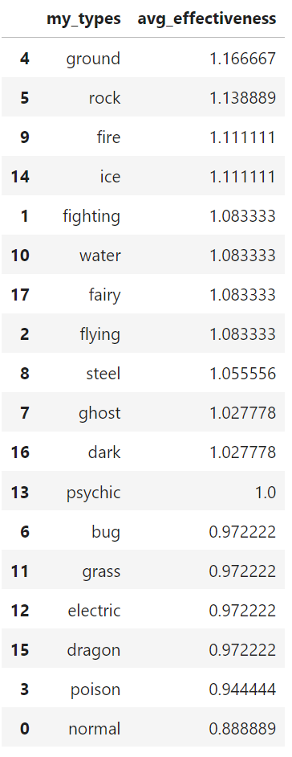
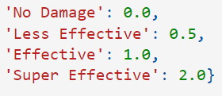
11) How does the type effectiveness look for each Pokémon type?

Slide 21
Pokémon Team Suggestion:

Slide 22
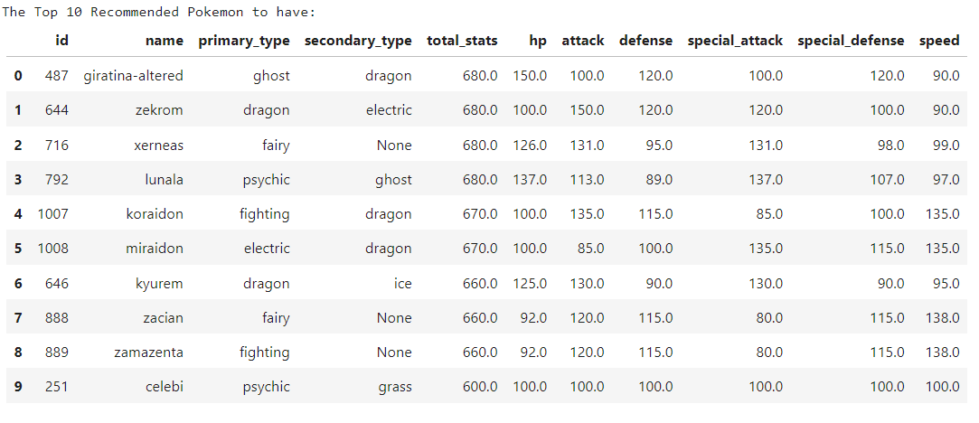
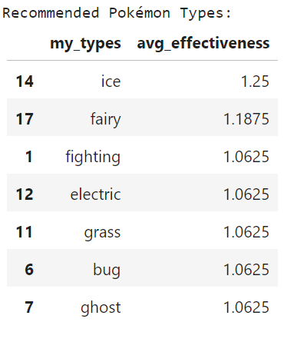
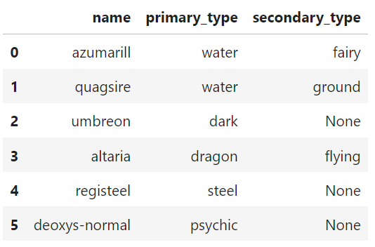
World Champions’ Opponent’s Team
from World Championship Roster

Slide 23
Thank You
Gotta Catch ‘Em All!

